Slide 1
EDUC2323 Computer Programming as a Tool for Learning
Lists, Strings and Boolean Operators

Slide 2
Plan
Scratch blocks, concepts and techniques:
  Lists
  Manipulating text using ‘join’
  Boolean logic: and, or
Tasks
  Take a look at the 2 Question History Quiz
  Other sample projects for you to look at

Slide 3
Lists
Lists are called ‘arrays’ in lots of programming languages
Lists are a type of variable which can hold more than one ‘value’ (e.g. number or string) – useful to hold related bits of information that we need to access within a project
Each value in the list is ‘indexed’ by a number. Most programming languages start list indexes at 0 but Scratch starts at 1, to match the way humans count.
Lists are very flexible – we can add new values, delete or change existing values.
… using an ‘index variable’ we can access the different values in the list as we need them. To create a list, go to the Variables blocks category and click:

Slide 4
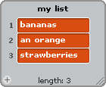

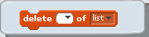
Lists are created ‘empty’ (i.e. containing no values)
When we create a list, a ‘list monitor’ appears on the stage.
  You can see what’s in your list and also…
  Type in values, and even…
  Import them from files (if you have lots)
Each time you add a value to a list,
its length will increase by 1.
The ‘add thing to mylist’ block adds a new value at the end of the list. But…
To access or change values in the list you need to know the ‘index’ of the value you want to change:
Using the following blocks you can also change or delete values anywhere else in the list

Slide 5








Other useful list-related blocks
A useful technique for quizzes and question/answer style games
Two (or more!) lists
One common index variable

Slide 6
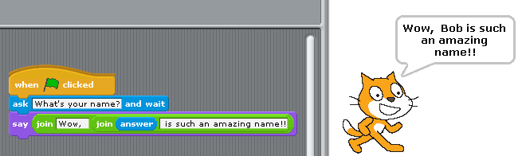
Strings and things
So far, our projects in class have only stored numbers in variables. But they can also store ‘strings’.
Strings are made of letters, words, or other characters (e.g., banana; January 2009; You lose!).
Strings can be stored in variables just like numbers
(If you try to use a string variable in a maths calculation, Scratch will regard it as a ‘0’)
You can join strings using

Slide 7
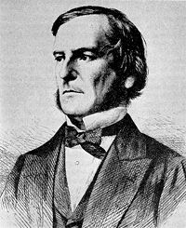

Boolean Operators
Named after 19th century English
mathematician George Boole
Boolean operators result in either true or
false outcomes
Whenever you see a hexagon-shaped block in
Scratch it means that you can use a Boolean operator
Boolean expressions can be combined in certain ways
  An and operator is true when both parts are true
  An or operator is true is when either part is true
  A not operator is true when the blocks inside are false

Slide 8

AND
Does this condition apply to you?
If you are a girl and you are
wearing blue
rtccomputers.wikispaces.com/file/view/Boolean%20logic%20and%20randomness.pptx

Slide 9


Slide 10
OR
You are a boy, or you are wearing blue
How many parts of the condition
must be true for you to stand up?
If both parts are true is it ok to stand up?
rtccomputers.wikispaces.com/file/view/Boolean%20logic%20and%20randomness.pptx

Slide 11
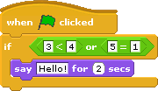

Slide 12
Finally
Look at the 2 Question History Quiz
An example of “live code”

